Slide 1


HackMT Team 3
Map My Degree

Slide 2
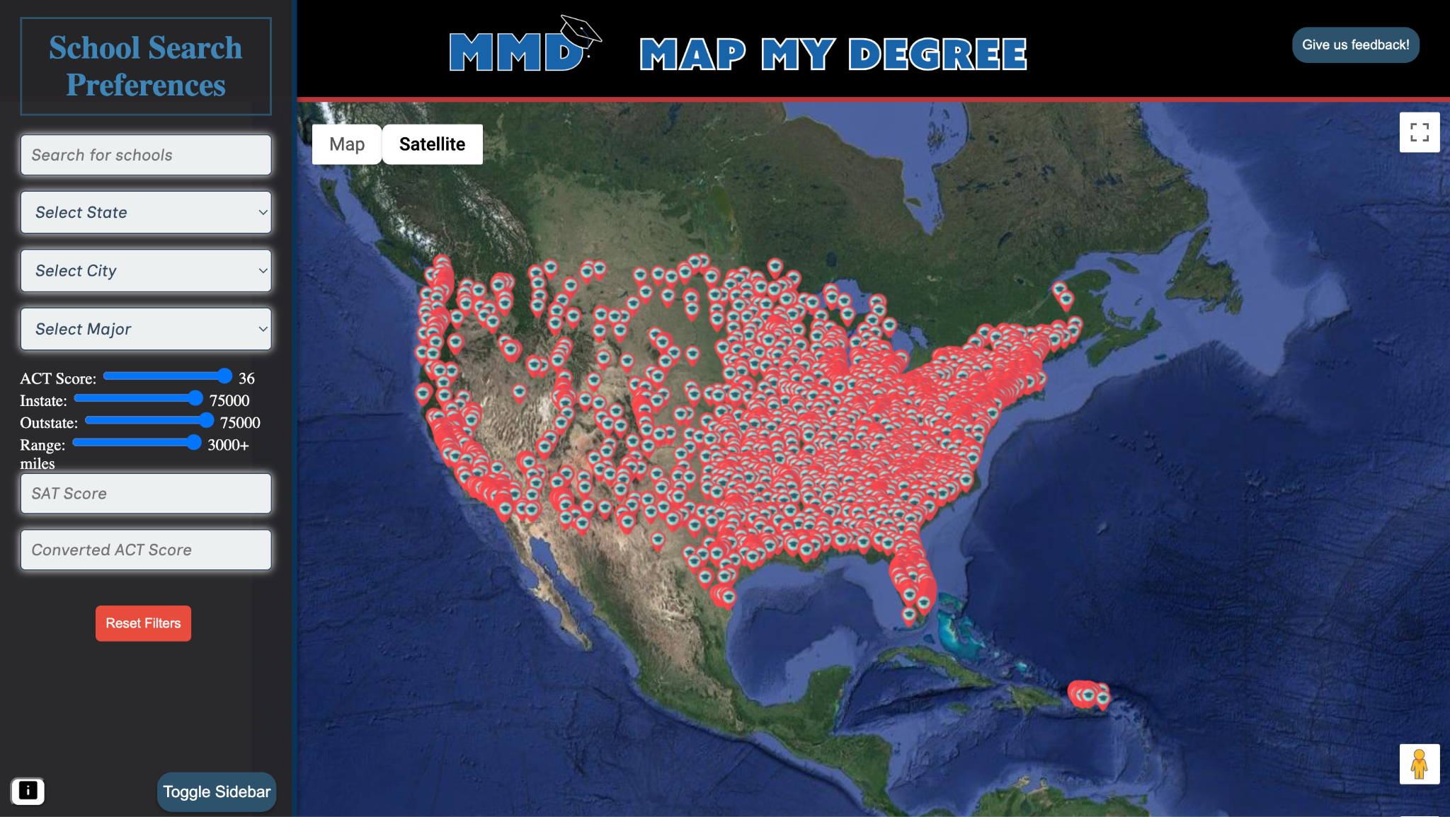
What is Map My Degree? Main Features
This helps high school students find the right college for them by implementing multiple search criteria.
The website features a map of the United States in which colleges will be displayed
A drop-down menu indicating each of the search criteria;
Depending on the criteria selected, colleges will disappear to reflect that they do not match the search

Slide 3





Project Stack
Github, TypeScript, CSS, HTML, Python

Slide 4

Obstacles
We had a rather large group, so it was difficult for us at times to stay on the same page
Understanding the data flow process
Many of us had very little to no front-end programing experience before this project

Slide 5
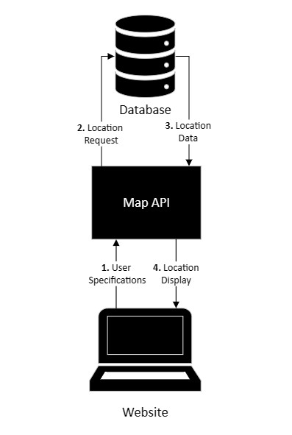
Workflow
The search is fed into the map API
Map request goes into the JSON
Data from the JSON fed into API
API generates display to be shown on the website

Slide 6
User Guide
The user inputs specific requirements for their desired college to the left
The map will then display all of the colleges/universities that meet those requirements
The user can then click on a specific institution, and a brief description will pop up
Notes:
Put a picture of the site homepage on this slide

Slide 7

Future Implementations
Prediction of acceptance based off of ACT/SAT scores and GPA using AI
Account login system using usernames and passwords
Adding other countries to choose colleges from
Display top universities with the use of a checkbox system

Slide 8


SUPPORT US!!!
If you want to see this project improve in the future, vote for us!
My name is Levi Driver, and I approve this message.

Slide 9
Contributors
Levi Driver
Ruth Dohrmann
Noah Sy
Jordan Cormier
Humza Aslam
Uriel Esquivel
Andrew Law
Jack Kelly
Joseph Saunderson
Gavin Liles
Quinton Smith
Anees Alawmleh
Febronia Azer
Steven Vongsiharath
Gilbert Tioluwanimofe
Adesanya Zarya
Amin Hani Adow
Adel mahfooz
Zachariah Rozier
Kyrillos Sharkawy
Bryan Hernandez-Trejo
Brandon Sandoval

